Slide 1


SIMATS ENGINEERING Saveetha Institute of Medical and Technical Sciences Chennai-602105
CSA0203 – C Programming
Hospital Blood Bank Automation System: Structured Data Handling Using Files and Arrays
Presented by
Leeba S (192565095)
Pavani B ( 192525248)
Harini G (192521186)
Guided by
Dr. S.K. Saravanan

Slide 2
INTRODUCTION
Blood banks play an important role in saving lives during emergencies.
Managing donor details, blood inventory, and patient requests manually is difficult.
A computerized system helps to store, manage, and retrieve blood-related information efficiently.
This project uses arrays and file handling concepts for structured data management.

Slide 3
PROBLEM STATEMENT
Manual blood bank record management requires more time and effort.
Difficulty in finding available blood groups quickly.
Maintaining donor and patient records manually may cause errors.
Updating blood stock information is challenging.
Emergency blood requirements need faster and more reliable access.

Slide 4
ABSTRACT
The Hospital Blood Bank Automation System automates blood bank operations.
It manages donor information, blood stock, patient requests, and transaction records.
Data is stored using file handling techniques.
Arrays are used for efficient data organization and processing.
The system reduces paperwork and improves accuracy.

Slide 5
EXISTING SYSTEMS
Blood donor details are recorded in register books or paper files.
Blood stock information is maintained manually.
Staff check blood availability by searching through records.
Patient blood requests are handled using handwritten records.
Updating donation and issue details requires manual changes.

Slide 6
PROPOSED SYSTEM AUTOMATED BLOOD BANK MANAGEMENT SYSTEM
Digital storage of donor and patient information.
Blood stock management using arrays.
Permanent data storage using files.
Quick search and update operations.
Improved accuracy and efficiency

Slide 7
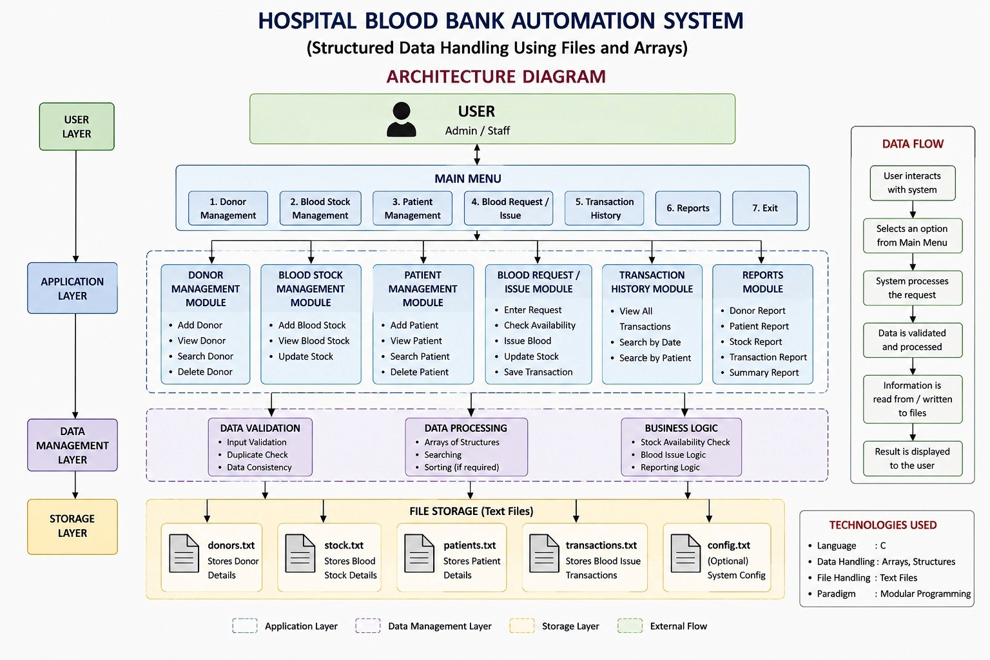

Slide 8
Module 1 – Donor Management Module
The Donor Management Module handles all information about blood donors. It allows the admin or staff to register new donors and maintain their records.
Add new donor details such as Donor ID, name, age, gender and blood group.
Store contact number, address and donation date.
Search and update donor information.
Maintain the donor's blood donation history.
Use donor blood group information for updating the blood inventory.

Slide 9
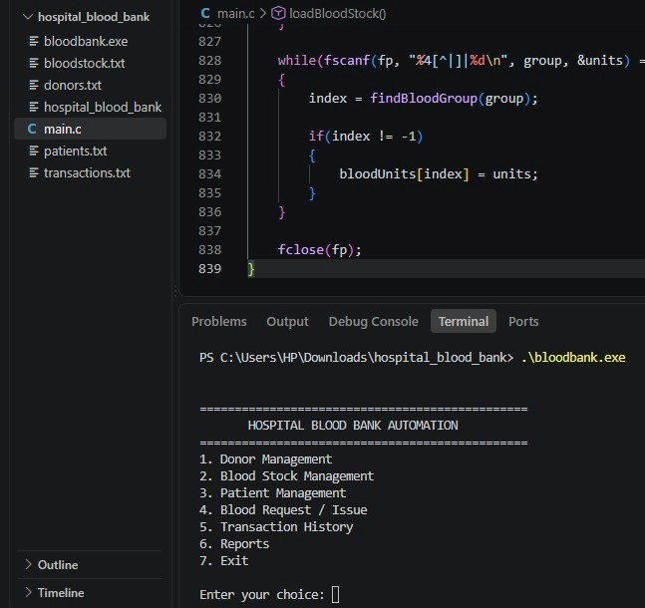
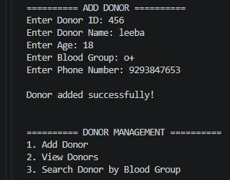

Slide 10
Module 2 – Blood Inventory Management
The Blood Inventory Management Module manages the blood units available in the blood bank. It helps staff monitor the quantity and status of different blood groups.
Store blood group and total available units.
Add blood units when a donor donates blood.
Reduce the available units when blood is issued.
Check the availability of a particular blood group.
Maintain blood expiry dates.
Provide updated blood stock information to staff.

Slide 11
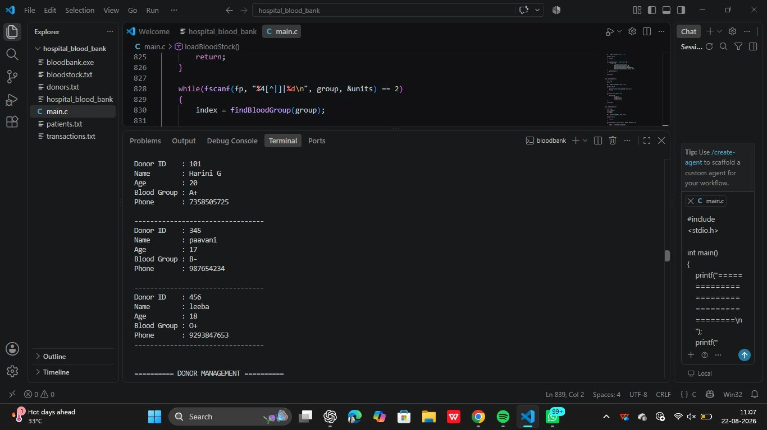

Slide 12
Module 3 - Patient Request & Record Management
This module manages patient blood requests and the related records.
Register patient blood requests.
Store Request ID, patient name, blood group and units required.
Check whether the requested blood is available.
Issue blood and update inventory.
Save and update donor, inventory and patient records.
Generate reports such as donor list, blood availability and issued blood details.

Slide 13
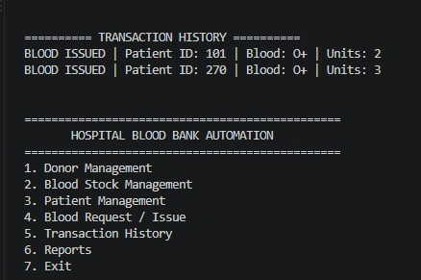
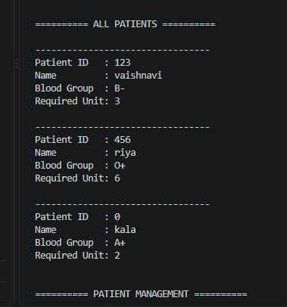

Slide 14
FUNCTIONALITIES
Donor Management: Add, search, and update donor details.
Blood Stock Management: Track available blood units and update stock.
Patient Management: Handle blood requests and issue records.
File Handling: Store and retrieve data using files.
Reports: Display blood availability and transaction details

Slide 15
CONCLUSION
The Hospital Blood Bank Automation System simplifies blood bank management.
It provides efficient storage and retrieval of donor, patient, and blood stock details.
The system reduces manual work and improves data accuracy.
File handling and arrays help in structured data management.
It provides a faster and reliable solution for emergency blood requirements.

Slide 16
REFERENCES
Khan, I., Jiya, Krishan, Tanwar, Y., & Yadav, P. (2024). A Comprehensive Blood Bank Management System for Efficient Resource and Staff Handling in Service Centers. IJR-Granthaalayah, 12(12), 152–161.
Bawankar, G., Raut, S., Sharnagate, D., Bhoyar, K., & Shende, T. (2024). Development of Blood Management System Application Using Machine Learning. IJRASET. doi:10.22214/ijraset.2024.65428
Kumar, A.K., Pasha, M.S., Pingili, M., Prasanthi, B., Gupta, Y., & Parameswar, M. (2025). An Effective Blood Bank Tracking System Integration Incorporating Fuzzy Logic and Information Security Using AI. Hybrid Intelligent Systems (Springer).
Khan, S.A. et al. (2025). IoT Based E-Blood Bank System for Real Time Hospital Monitoring and Inventory Management. IJIRCST, 13(3).
Odeh, M. et al. (2024). Informing the State of Process Modeling and Automation of Blood Banking and Transfusion Services Through a Systematic Mapping Study. Journal of Multidisciplinary Healthcare, 17, 473–489.

